Slide 1
Agenda
Introduction
Project timeline
Requirements
Use cases
Sequence diagrams
App. Development
Conclusion

Slide 2
Introduction
MM platform takes benefit from the technology of big data for providing personalized services based on processing real-time data.
Information Curation and Service Curation layer are important in the MM platform.
This project provide a new function of falling down detection for e-Health services.
Identify use cases and sequence diagrams, which support for software development.
Develop a demo version as mobile app, which can be able to reuse for MM.

Slide 3
Requirements
Function requirements
The system shall detect the falling down event
The system shall check the status of user
The system shall request the emergency services
The user shall cancel the emergency service request

Slide 4
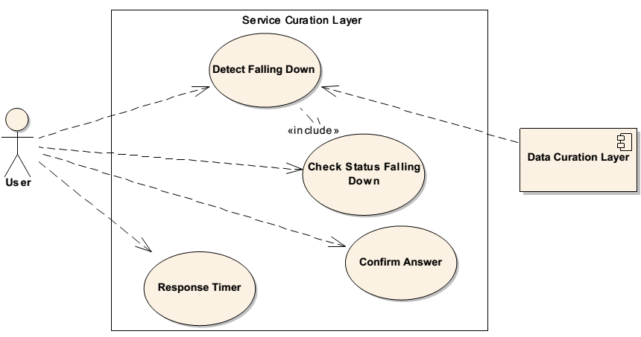
Use case diagram (ICL)
Fig. 1 Use case diagram for falling down detection in Information Curation layer

Slide 5
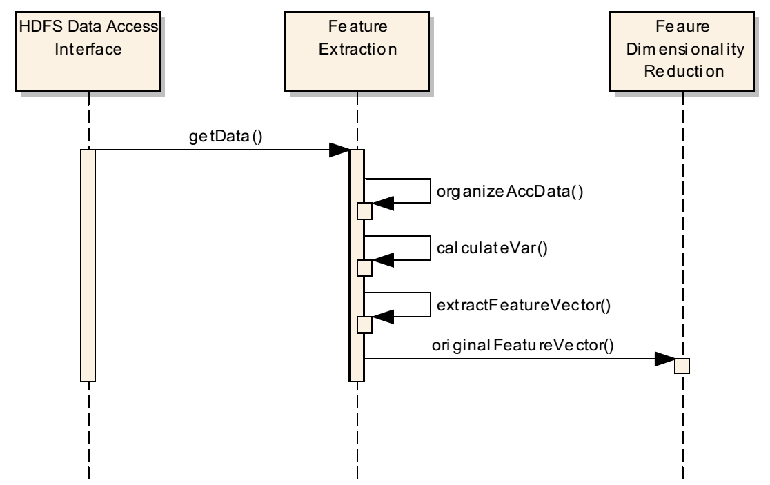
Use cases 1
ID | UC-ICL1
Title | Extract Feature
Description | The accelerometer data stored from data source in the Data Curation Layer is used to extract the features. This feature set then supports to detect activities.
Primary Actor | Data source
Preconditions | The data must be available in the data source
Postconditions | Features are available
Main Success Scenario | 1. Receive the personal data from the data source in the Data Curation Layer. 2. Identify the accelerometer data among the personal data. 3. Calculate the value of identified variables which relate to the data attribute. 4. Organize features into a vector
Frequency of Use | When using the falling down detection service
Status | Completed
Owner | Group2
Priority | Medium
Fig. 2 Sequence diagram for use case 1

Slide 6
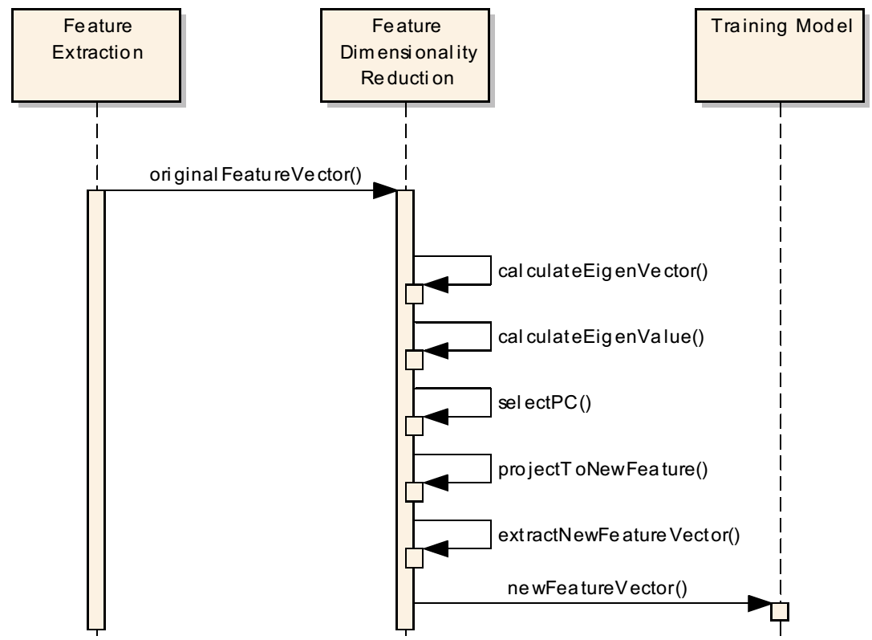
Use cases 2
ID | UC- ICL2
Title | Reduce feature dimensionality
Description | The feature data needs to be reduced the dimensionality to remove the irrelevant information.
Primary Actor
Preconditions | The feature data is already extracted from the accelerometer data
Postconditions | The set of features with high weights.
Main Success Scenario | Get the original feature vector Calculate eigenvectors and eigenvalues Select the principal components Project to the new feature space Organize the new features into a vector
Frequency of Use | When using the falling down detection service
Status | Completed
Owner | Group2
Priority | Medium
Fig. 3 Sequence diagram for use case 2

Slide 7
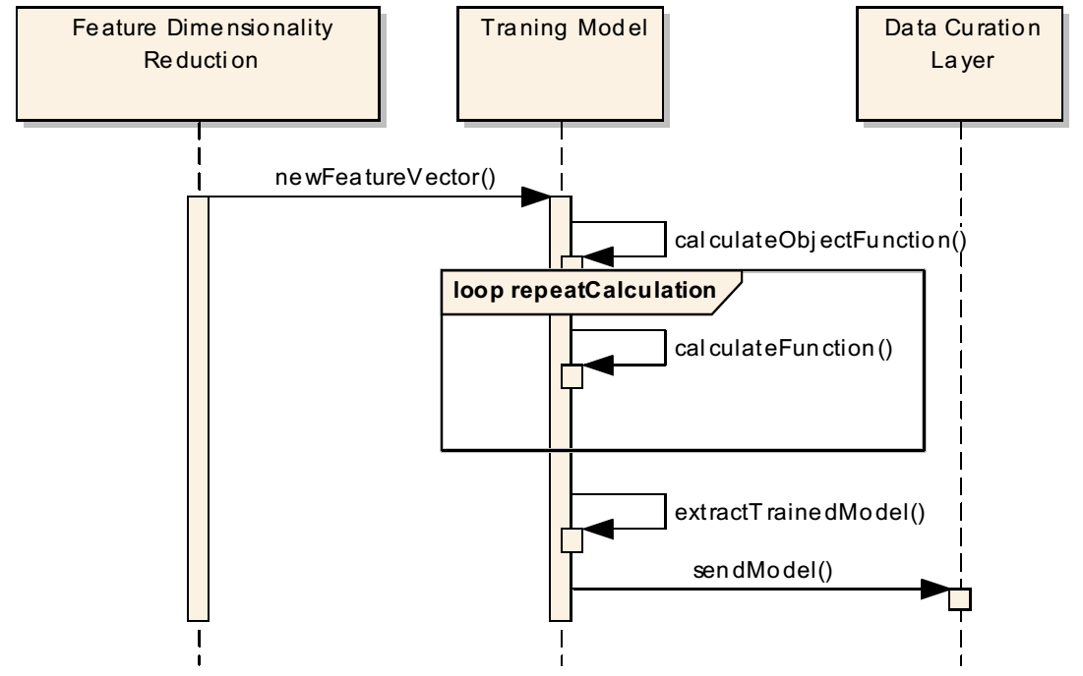
Use cases 3
ID | UC- ICL3
Title | Train model
Description | The features with high weight extracted from the training dataset are used to generate the model of classifier.
Primary Actor
Preconditions | The training features with high weight are available
Postconditions | The model of classifier is trained
Main Success Scenario | Provide the training feature data with two activity classes: normal activity and falling down. Start training the model Calculate the object function Repeat the step 2 and 3 until the object function is satisfied. Store the trained model of classifier in the Data Curation Layer
Frequency of Use | In the first time of use
Status | Completed
Owner | Group2
Priority | Medium
Fig. 4 Sequence diagram for use case 3

Slide 8
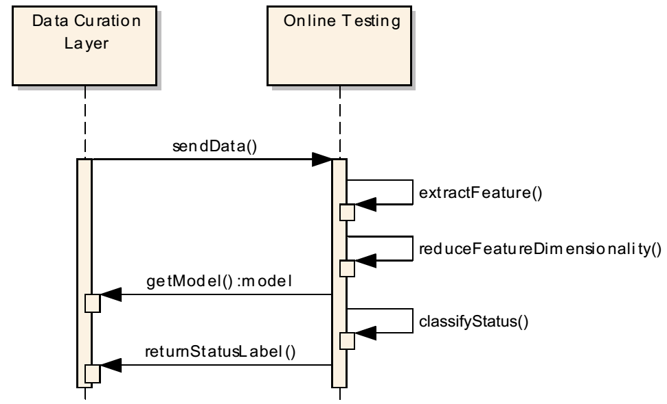
Use cases 4
ID | UC- ICL4
Title | Detect falling down
Description | The features with high weight extracted from the testing data are provided to detect the falling down activity.
Primary Actor
Preconditions | The features with high weight are available The trained model of classifier after training is available
Postconditions | The falling down is recorded with user’s information.
Main Success Scenario | Input the features from the Data Curation Layer. Request the trained model from the Data Curation Layer. Extract the features Reduce the feature dimensionality Identify the class of testing data as normal or falling down activity. Send the detected result to the Data Curation Layer.
Frequency of Use | When using the falling down detection service
Status | Completed
Owner | Group2
Priority | High
Fig. 5 Sequence diagram for use case 4

Slide 9
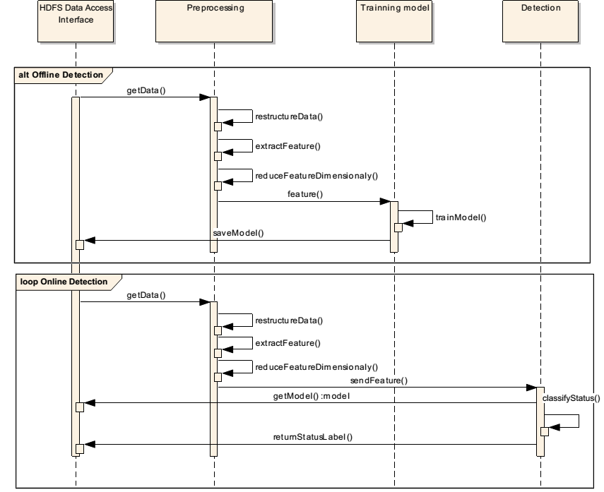
Sequence diagram (ICL)
Fig. 6 Sequence diagram for Information Curation Layer

Slide 10
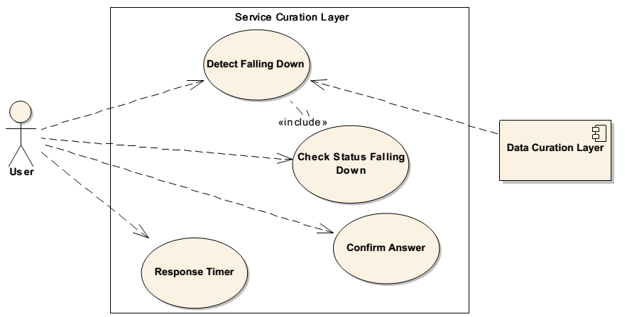
Use case diagram (SCL)
Fig. 7 Use case diagram for service interaction in Service Curation layer

Slide 11
Use cases 5
ID | UC-SCL1
Title | User status checking
Description | User has to confirm the request from service curation layer for checking the status
Primary Actor | User
Preconditions | Falling down state is detected
Postconditions | A decide is made based on the user answer
Main Success Scenario | 1. A warning notice is sent from the service curation layer to the user 2. The user confirms the notice 3. There are two answers: a. If “Yes”, the mobile device sends the feedback to service curation layer. The system request doctors for the user. b. If “No”, the service curation layer requests user to confirm on the mobile screen.
Extension
Frequency of Use | Whenever the falling down detection case
Status | Completed
Owner | Group2
Priority | Medium

Slide 12
Use cases 6
ID | UC- SCL2
Title | Screen confirmation
Description | The server requires the user to confirm again to ensure that user does not need a help.
Primary Actor | User
Preconditions | User answers “No” from the status checking
Postconditions | A decision of message sending is processed based on the user answer
Main Success Scenario | 1. A confirmation is asked by the service curation layer and displayed on screen. 2. The user verifies the confirmation 3. There are three cases: a. If the answer is “Yes”, the feedback is sent to the service curation without help request. b. If the answer is “No”, the feedback is sent to the service curation to request a help from doctors c. If the confirmation is entered after two seconds, feedback is also sent to the service curation with a help request.
Extension
Frequency of Use | Whenever the falling down detection case
Status | Completed
Owner | Group2
Priority | Medium

Slide 13
Use case 7
ID | UC-SCL3
Title | Response Timer
Description | If the user does not confirm the request from the service curation layer, the feedback is automatically sent.
Primary Actor | User
Preconditions | Falling down state is detected
Postconditions | A rescue message is sent
Main Success Scenario | 1. A warning notice is sent from the service curation layer to the user 2. The user does not reply 3. The timer counter is activated on the service curation layer 4. After 30 second without any confirmations, the service curation require doctors for user
Frequency of Use | Whenever the falling down detection case
Status | Completed
Owner | Group2
Priority | Medium

Slide 14
Sequence diagram (SCL)
Fig. 8 Sequence diagram for Service Curation layer

Slide 15
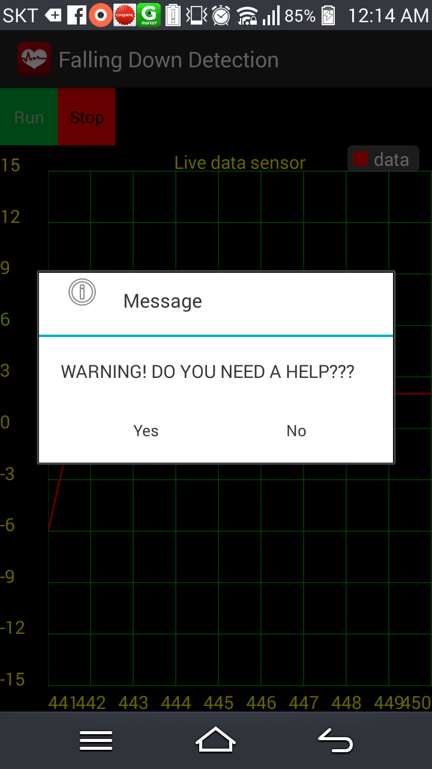
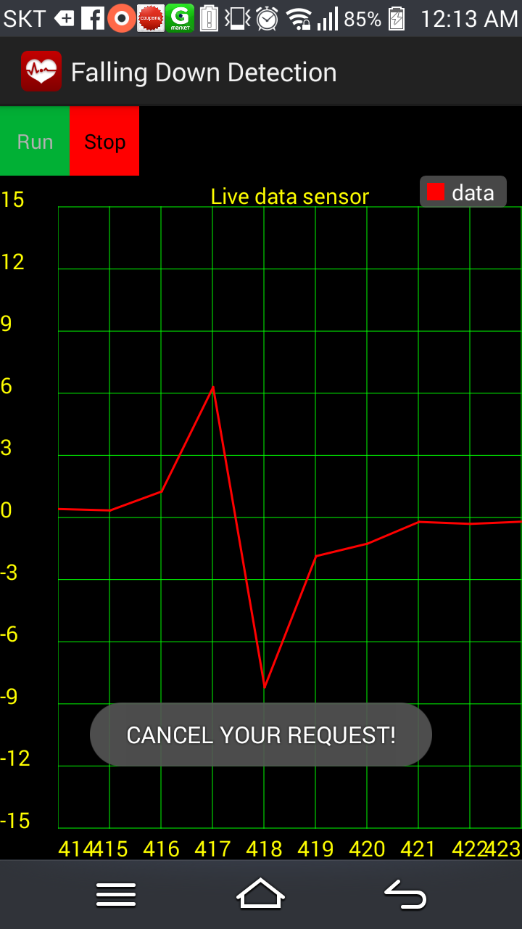
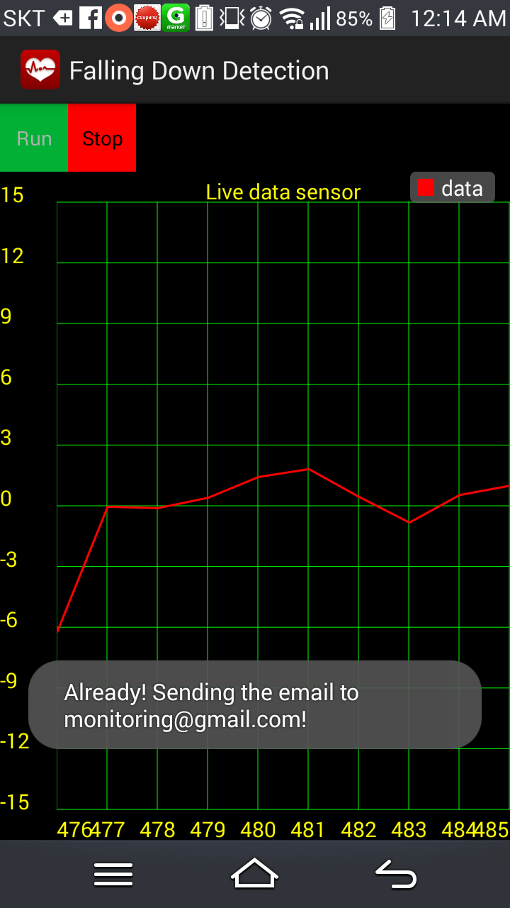
App development
Fig. 9 Sequence diagram for Service Curation layer

Slide 16
Conclusion
Provide a new functionality of falling down detection for MM platform
Write the use cases and sequence diagram
Falling down detection
Service interaction
Develop a mobile app as demo
This module can be able to support for MM platform as an e-Health service

Slide 17
THANK YOU FOR LISTENING !

